Slide 1
Chapter 4 Object-Oriented Analysis and Design in a Nutshell

Slide 2
Chapter 4 Topics
Logical and physical models and iterative and incremental development concepts in OOA and OOD
Need for the Unified Modeling Language (UML) and model-driven development
Creation and interpretation of UML use case diagrams, class diagrams, and sequence diagrams
How the three-tier design approach is used in OOA and OOD
How UML diagrams are developed for a business system development project

Slide 3
Understanding OOA and OOD
System analysis
To study, understand, and define the requirements for a system
System requirements
Define what the system needs to accomplish for the users in business terms

Slide 4
Understanding OOA and OOD
Models
Depict some aspect of the required system
Logical models
Show what is required in the system independent of the technology used to implement it
Physical models
Show how to implement and integrate system components using specific technology
System design
Creating physical models rather than logical models

Slide 5
Understanding OOA and OOD
Model-Driven Development
Creating logical models of the system requirements during analysis phase
Creating physical models of the system requirements during design phase

Slide 6
Understanding OOA and OOD
Iterative Development
Analyze
Design
Implement
Repeat
Example: Waterfall Method

Slide 7
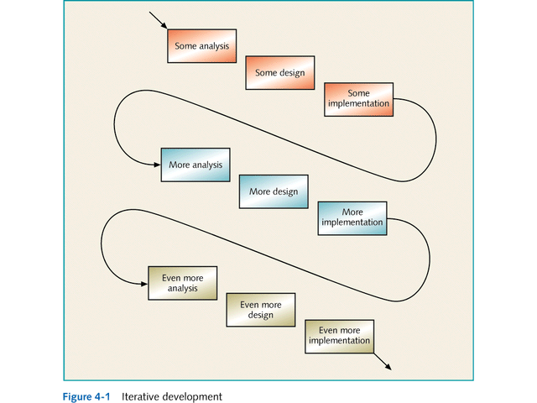

Slide 8
Understanding OOA and OOD
Incremental Development
Some of the system is completed and put into operation before entire system is completed
Spiral Model
Greatest challenges are identified and addressed in first iterations
Subsequent iterations build on completed ones

Slide 9
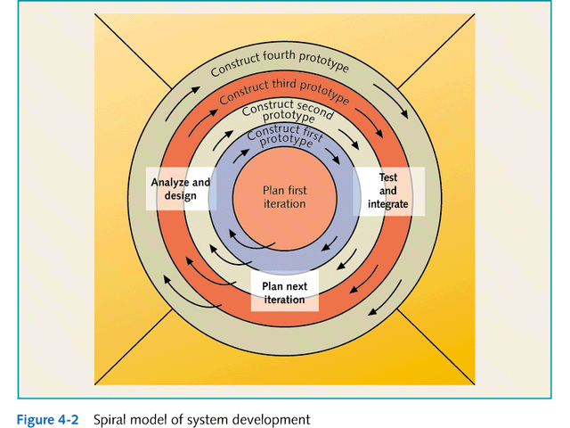

Slide 10
Understanding the Unified Modeling Language
OO development requires a collection of models that depict system requirements and designs
UML defines a standard set of constructs and diagrams used to model OO systems

Slide 11
Understanding the Unified Modeling Language
UML
Created by:
Grady Booch, James Rumbaugh, and Ivar Jacobson (Rational Software)
Accepted as standard by:
the Object Management Group (OMG)
Industry association dedicated to improving OO development practices
See www.rational.com for information

Slide 12
Understanding the Unified Modeling Language
Creating & Interpreting Use Case Diagram
First step: define the main system functions
Each system function is called a use case
Allows developers to:
divide up the work
focus on specific system functions

Slide 13
Understanding the Unified Modeling Language
Creating & Interpreting Use Case Diagram
Use case diagram depicts:
Use case
Scenarios → variations of the same function
Actor
Entity using the system

Slide 14
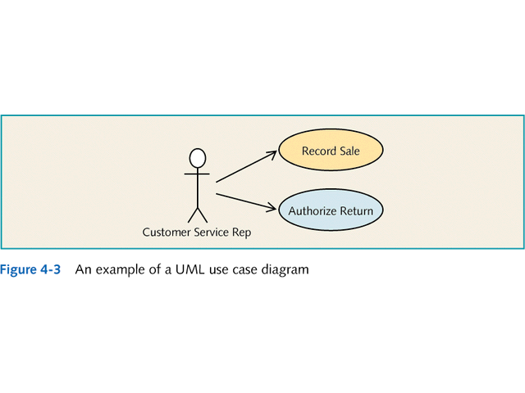

Slide 15
Understanding the Unified Modeling Language
Creating & Interpreting Use Case Diagram
Identify use cases by identifying events the system must respond to:
External event
Something that happens outside the system
Temporal event
Occurs at a specific point in time
State event
Occurs when state of an object changes

Slide 16
Understanding the Unified Modeling Language
Creating & Interpreting Use Case Diagram
Document and describe use cases:
Dialogue or script
List of steps followed by actor and system
Activity Diagram
Depiction of use case scenarios

Slide 17
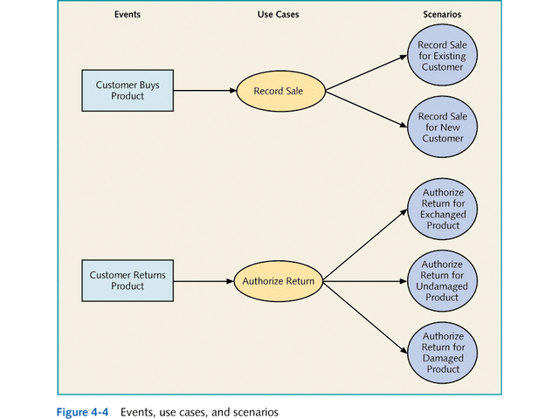

Slide 18
Understanding the Unified Modeling Language
Creating & Interpreting the Class Diagram
Class Diagram
Depicts the classes used in a system
Differentiates between types of classes
Italics indicate an abstract class
Demonstrates the association relationships between classes
Depicts generalization/specialization hierarchies
Inheritance
Static model

Slide 19
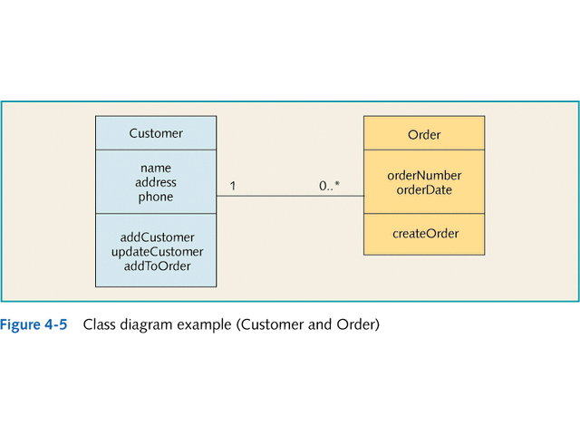

Slide 20
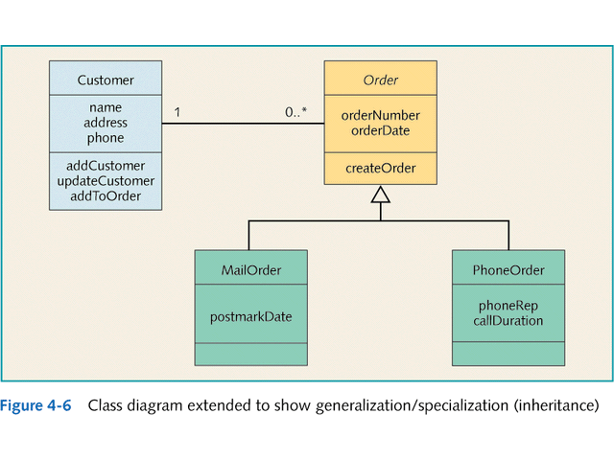

Slide 21
Understanding the Unified Modeling Language
Creating & Interpreting Sequence Diagram
Sequence Diagram
Depicts interactions between the actor and objects in the system
For each use case or scenario
Represent time sequences (lifelines)
Specifies when the object is active (executing or controlling part of the interaction)
Dynamic model

Slide 22
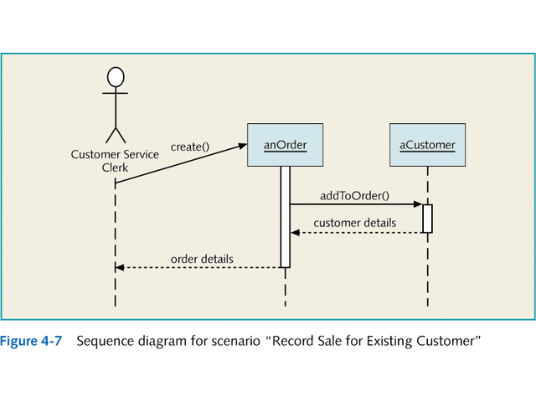

Slide 23
Using 3-Tier Design in OO Development
Tier 1
Identify and specify problem domain classes
Classes of objects that involve the users’ work
Tier 2
Define GUI classes
Allow user to interact with the problem domain classes
Tier 3
Specify access classes
Allow problem domain classes to interact with the database

Slide 24
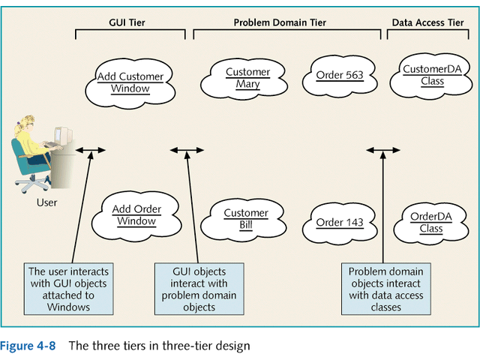

Slide 25
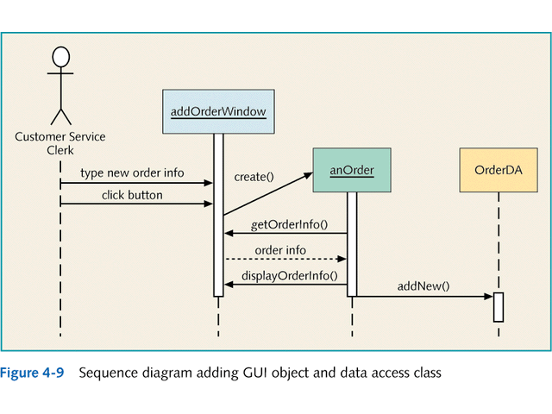

Slide 26
Using 3-Tier Design in OO Development
3-Tier Design
Supports objective of creating loosely coupled system components
Can modify one component with minimal effects on other components
Provides a framework for defining OOA and OOD
Works well with iterative and incremental development

Slide 27
Introducing the Bradshaw Marina Case Study
Exploring Background of Bradshaw Marina
Privately owned corporation that rents boats and provides boat services on a lake
Needs automated system to:
Track:
Customers, leased slips, and boats in the slips
Tasks: creating lease, computing lease amount, assigning boats
Search:
vacant slips leased to specific customers
Implement billing system (future feature)

Slide 28
Introducing the Bradshaw Marina Case Study
Identifying Bradshaw Use Cases and Scenarios
First step in OOA process:
Identify use cases that fall within scope of system
Focus on:
Customers
Boats
Slips

Slide 29
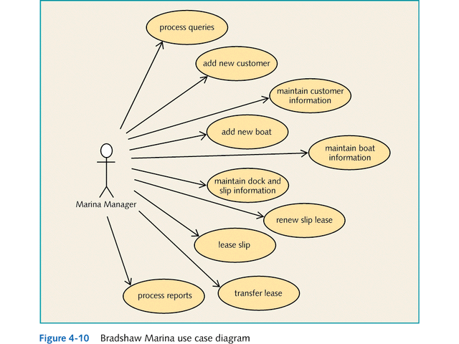

Slide 30
Introducing the Bradshaw Marina Case Study
Identifying Bradshaw Problem Domain Classes
Process
Begin an initial class diagram that includes potential classes
Gain information about the system
Refine class diagram
Show generalization/specialization hierarchies
Identify/model association relationships between classes

Slide 31
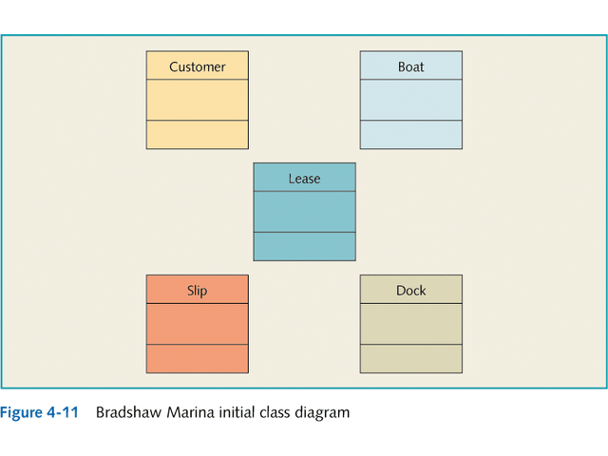

Slide 32
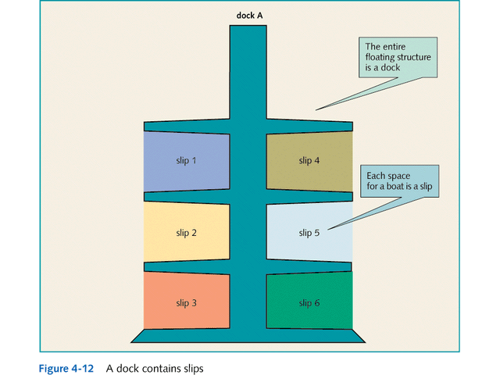

Slide 33
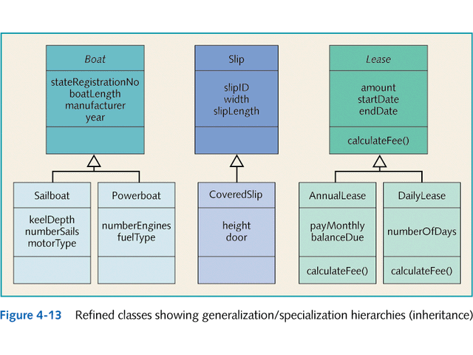

Slide 34
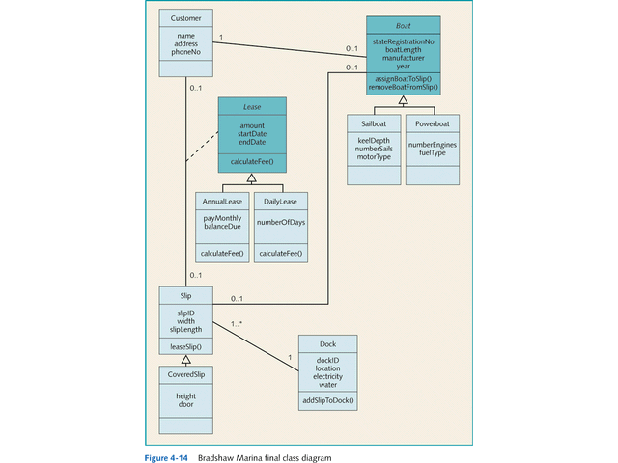

Slide 35
Introducing the Bradshaw Marina Case Study
Identifying Bradshaw Sequence Diagram
Process
Create a sequence diagram for each scenario of each use case
Start as logical model showing only problem domain objects
When move to OOD:
Expand diagram to show GUI objects and data access classes

Slide 36
